Slide 1
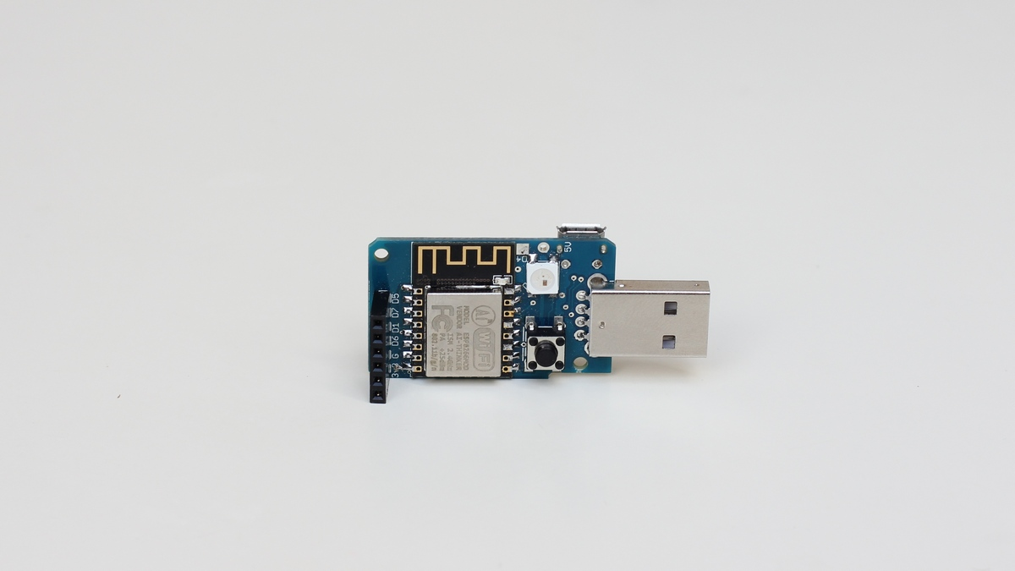
What is inside?
ESP8266
RGB LED
Micro USB
Button
IO Ports

Slide 2
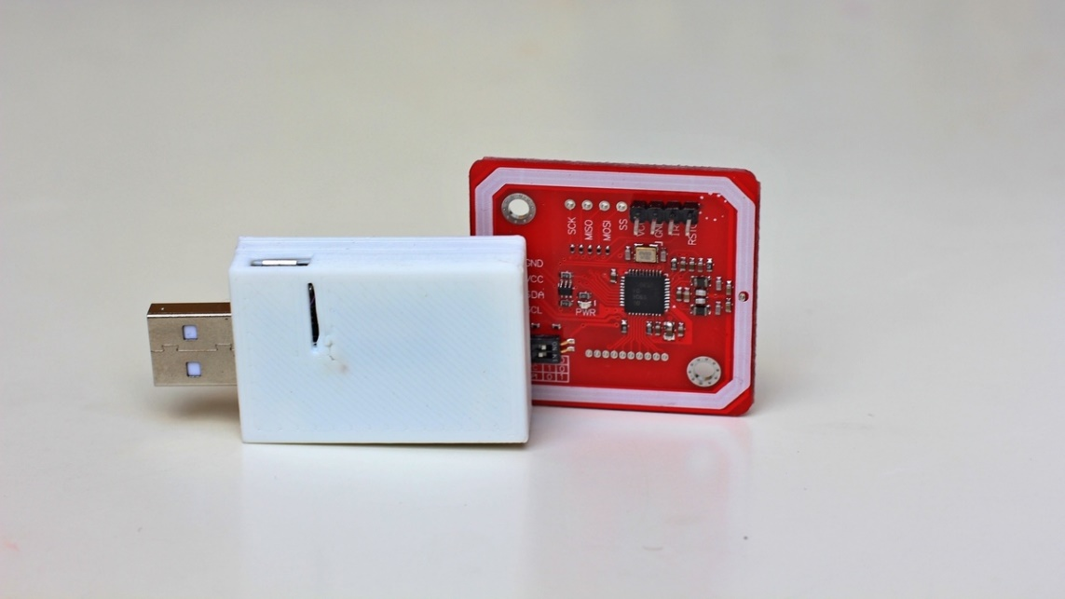
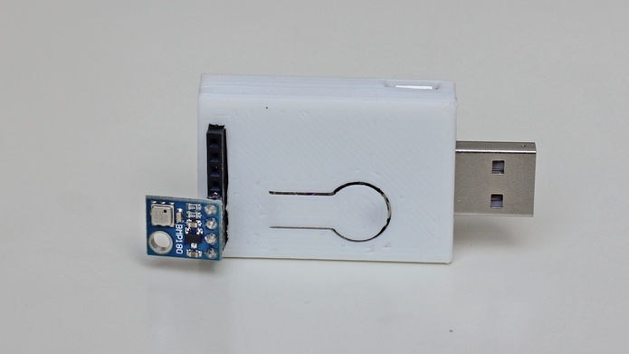
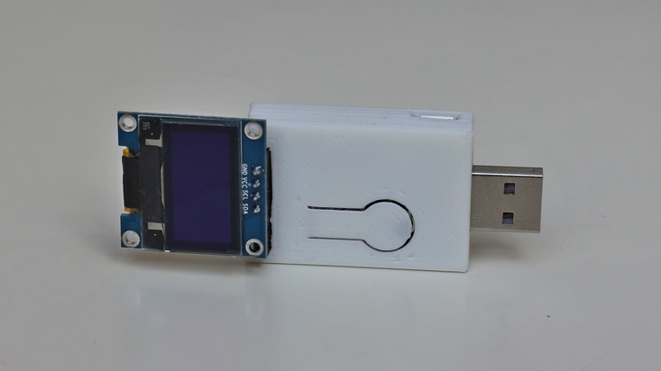
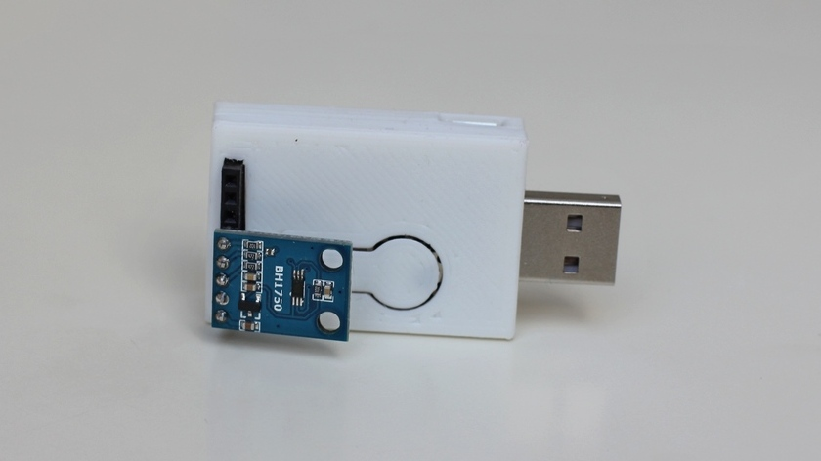
Play with cool Extensions
RFID / NFC
Temperature
... and many more!
OLED
Light

Slide 3


